Slide 1
Industrial Pharmacy II
By
Dr. Mohammed Sabbar
4th Oct. 2018
http://bit.do/ex2a6

Slide 2
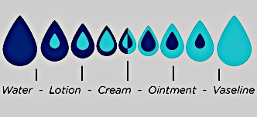
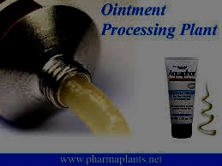
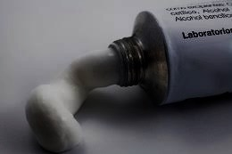
Semisolids

Slide 3
Introduction
The bulk applied to the skin act:
as vehicles for medication
emollients or
as protective or occlusive dressings),
The small portion is applied to mucous membranes (buccal, rectal, vaginal, urethral, nasal, otic and cornea).
Their composition and method of manufacturing are varied with variation of their types.
Advantages and disadvantages?
are related to their safety, ease of use and manufacturing, rheological properties and stability.

Slide 4
Types of semisolid
Ointments :
Creams :
Gels and jellies:
Miscellaneous: like Pastes, rigid foams, plasters and glycerogelatins
Notes:
Ointments (Epidermic, endodermic and diadermic types), topical (skin and mucous mem.) , ophthalmic or nasal, Medicated and cosmetic
Creams : Mainly topical (skin and muc. Mem.), medicated and cosmetic
Gels and jellies: Hydrogels, emugels, organogels, insitu-gels, topical, ophthalmic or nasal
Miscellaneous: Pastes, rigid foams, plasters and glycerogelatins

Slide 5
Ideal Properties Of Semi-solid Dosage Forms
Physical properties:
Physiological properties:
Application properties:
Notes:
Physical properties: Smooth texture, elegant, non dehydrating , non gritty , non staining and non hygroscopic
Physiological properties: Non irritating (irritation test) , do not alter membrane / skin functioning , miscible with skin secretions.
Application properties: Easily applicable with efficient drug release, high aqueous wash ability.

Slide 6
The materials
In general, are:
API (1 or more), (solid or liquid)
Base or vehicle :
Hydrocarbon
Absorption (anhydrous and emulsion base),
Water removable and
Water soluble bases.
Gelling agents (for gels)
Stabilizers (Preservative, emulsifiers, viscosity enhancers, antioxidants..)
Humectants (in creams) = like polyols
The most important considerations are: lipophilicity, compatibility with other materials or package, particle size, safety, rheological properties, heat stability, physical and chemical stability .
Notes:
Active ingredients (one or more), (solid or liquid)
Base or vehicle : Hydrocarbon , absorption (anhydrous and emulsion base), water removable and water soluble bases.
Gelling agents (for gels)
Stabilizers (Preservative, emulsifiers, viscosity enhancers, antioxidants..)
Humectants (in creams) = like polyols

Slide 7
Bases or vehicles
Hydrocarbons (oleaginous): Solid like petrolatum (Vaseline®), white (pure) and yellow (with wax) types, and liquid (mineral oil like liquid paraffin).
Hydrocarbon waxes: Ozokerite (earth wax) and paraffin waxes (from petroleum) which are synthetic waxes developed from vegetable oils.
Oleaginous substances (vegetable oils): Peanut oil, almond oil, sesame oil and olive oils (need for antioxidants).
Notes:
Are used as carriers for API of other.
Are different types with different chemical compositions (single or compound), melting properties and density.
Hydrocarbons (oleaginous): Solid like petrolatum (Vaseline®), white (pure) and yellow (with wax) types, and liquid (mineral oil like liquid paraffin).
Hydrocarbon waxes, as naturally obtained, we have Ozokerite (earth wax) and paraffin waxes (from petroleum) which are synthetic waxes developed from vegetable oils.
Oleaginous substances (vegetable oils) like peanut oil, almond oil, sesame oil and olive oils may be involved within these bases. (need for antioxidants).
Fatty acids and alcohols: like stearic and palmitic acids (used with emulsion base), stearyl alcohol and cetyl alcohol (as emulsifiers).
Other bases of different sources like lanolin (animal), beeswax and carnauba (palm) wax.

Slide 8
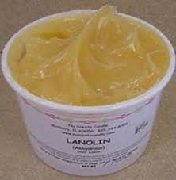
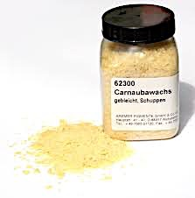
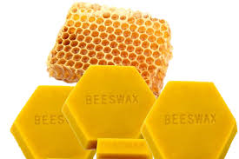
Bases or vehicles
Fatty acids and alcohols: Stearic and palmitic acids (used with emulsion base), stearyl alcohol and cetyl alcohol (as emulsifiers).
Other bases of different sources like lanolin (animal), beeswax and carnauba (palm) wax.
Notes:
Are used as carriers for API of other.
Are different types with different chemical compositions (single or compound), melting properties and density.
Hydrocarbons (oleaginous): Solid like petrolatum (Vaseline®), white (pure) and yellow (with wax) types, and liquid (mineral oil like liquid paraffin).
Hydrocarbon waxes, as naturally obtained, we have Ozokerite (earth wax) and paraffin waxes (from petroleum) which are synthetic waxes developed from vegetable oils.
Oleaginous substances (vegetable oils) like peanut oil, almond oil, sesame oil and olive oils may be involved within these bases. (need for antioxidants).
Fatty acids and alcohols: like stearic and palmitic acids (used with emulsion base), stearyl alcohol and cetyl alcohol (as emulsifiers).
Other bases of different sources like lanolin (animal), beeswax and carnauba (palm) wax.

Slide 9
Emulsifiers: Soaps or surfactants (one or combination) as stabilizers for bases (emulsion type)
Polyols: Glycerine, propylene glycol, sorbitol 70% and low mwt PEG. (to change the hydrophilicity and viscosity of bases) and (prevent drying out and improve its spreading).
Water soluble bases are prepared from mixtures of high- and low- mol.wt. PEG.s
Jellies are water soluble bases prepared from natural gums such as tragacanth, pectin, alginate or synthetic cellulose polymers.
Notes:
Emulsifiers like soaps and other surfactants (one or combination) used as stabilizers for bases (emulsion type) by increasing the viscosity or decreasing the interfacial tension.
Polyols like glycerine, PG, sorbitol 70% and low mol.wt PEG. They can change the hydrophilicity and viscosity of bases (prevent the creams from drying out and improve its spreading).
Water soluble bases are prepared from mixtures of high- and low- mol.wt. PEG.s
Jellies are water soluble bases prepared from natural gums such as tragacanth, pectin, alginate or synthetic cellulose polymers.

Slide 10
Bases:
1- Hydrocarbon: Petrolatum and white ointment, with 5% beeswax,
2- Absorption: Anhydrous form and the emulsion form
Notes:
The absorption bases are of two types: the anhydrous form and the emulsion form. Anhydrous lanolin and hydrophilic petrolatum are examples of anhydrous vehicles that absorb water to form water-in-oil emulsions.

Slide 11
example of a water-in-oil absorption base type vehicle that does not have any lanolin or its derivatives in the formula.
Notes:
Hydrophilic ointment is an example of a water-in-oil absorption base type vehicle that does not have any lanolin or its derivatives in the formula.

Slide 12
3-Water-Removable Bases : are oil-in-water
emulsions and are referred to as “creams.”
4- Water-Soluble Bases : prepared from mixtures of high- and low-molecular-weight of PEG
Notes:
The polyethylene glycol vehicles are softened by the addition of water, owing to solution of the glycols. The USP states that 5% of the polyethylene glycol 4000 may be replaced with an equal amount of stearyl alcohol when 6 to 25% of aqueous solution is to be added to the vehicle.

Slide 13
Pastes,
Gels
Ophthalmic ointments require specific types of bases
Preservatives are varied with variation of semisolids (irritancy, compatibility, stability, free water ratio and potency variations) and needed for evaluation using preservative efficacy tests.
Notes:
Pastes are dispersions of high concentrations of insoluble powdered substances (20 to 50%) in a fatty or aqueous base. The fatty bases are less greasy as well as stiffer in consistency than ointments because of the large amount of powdered material present.
Gels are usually clear transparent semisolids containing the solubilized active substance. Carbomer 940 swells when dispersed in water in presence of such alkaline substances as triethanolamine.
Ophthalmic ointments require specific types of bases (more soft and non irritant).

Slide 14
Methods of preparation
Primarily depend on the nature of ingredients, quantities (small or large scale)
In general , we have:
- Incorporation (cold method),
- Trituration (mixing principle with milling).
Levigation (use of levigating agent)
Fusion (Hot method).

Slide 15
The general steps for semisolid
Preparation and selection of ingredients
Milling or homogenization (if needed)
Melting (for meltable heat stable ingredients) = fusion
Mixing (of liquid, of solids, of semisolids)
Dispersing /emulsification/ incorporation
Milling or homogenization
Filling and packaging : inside the selected containers (tubes or jars), (glass, metal or plastic), followed by labeling
Storage
Q.C. (in-processing and finishing)

Slide 16
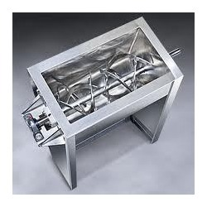
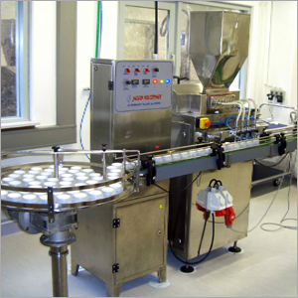
Equipment involved
Mixers : Kettle and tank fitted with agitator (high shear mixers) , tumbler, Blade mixers and kneaders
Homogenizers, colloid mills, roller mills, hammer mill, ball mill, micronizer
Filling and packaging machines

Slide 17
Storage properties:
Storage of semisolids should be at temperatures not exceeding 25° C unless otherwise authorized.
They should not be allowed to freeze and must be stored in a well-closed container or, if the preparation contains water or other volatile ingredients, store in an air-tight container.
The containers are preferably collapsable metal tubes from which the preparation may be readily extruded.
If the preparation is sterile, store in a sterile, airtight, tamper-proof container.

Slide 18
Evaluation
As parameters monitored during processing: Particle size and morphology, Viscosity, Preservative effectiveness
Microbial content
Minimum fill and content uniformity.
Leakage test
Sterility (for sterile products)

Slide 19
Microbial content
Microbial limits are stated for each preparation in the USP
10 gm or 10 ml of the products is tested after suitable dilution and added to a specific media and incubate between 30-35 °C for 24-48 h
For purpose of confirming a doubtful result, a retest on 25 gm specimen of the product may be conducted.

Slide 20
Minimum Fill
Select 10 filled containers, remove any labeling.
Clean and dry the outside of the containers, and weigh individually.
Quantitatively remove the contents from each container, cutting the latter open and wash with a solvent.
Dry and weigh again each empty container.
The difference between the two weights is the net weight of the contents:

Slide 21
The average net content of the 10 containers is not less than the labeled amount, and the net content of any single container is not less than 90% of the labeled amount where the labeled amount is 60 g or 60 ml or less .
Or not less than 95% of the labeled amount where the content is 60 g/or ml – 150 g /or ml.
If this requirement is not met, determine the content of 20 additional containers.

Slide 22
The average content of the 30 containers is not less than the labeled amount, and the content of not more than 1of the 30 containers is less than 90 % of the labeled amount where the labeled amount is 60 g or 60 ml or less .
or not less than 95% of the labeled amount where the content is 60 g/or ml – 150 g /or ml.

Slide 23
Content Uniformity
Monitoring Output | Acceptance Criteria (n = 10) | Sampling Plan
Content Uniformity | 90- 110% | 3 – 4 units from beginning, middle and end of filling cycle; total = 10 units
 | SD ≤ 4.2%
● The average result of 10 individual results must meet the release limit for assay. ● The usual sample size for testing ranges between 0.5 and 1.5 g per sample assay.

Slide 24
Dissolution Testing:
It is primary used as a quality control procedure to determine product uniformity.
secondary as a means of assessing the in vivo absorption of the drug in terms of a possible in vitro/vivo correlation.
For cream/ointments, the Franz in vitro flow through diffusion cell or microdialysis has been modified by using silicon rubber membrane barrier to stimulate percutaneous dissolution unit for testing purpose.

Slide 25
